Slide 1

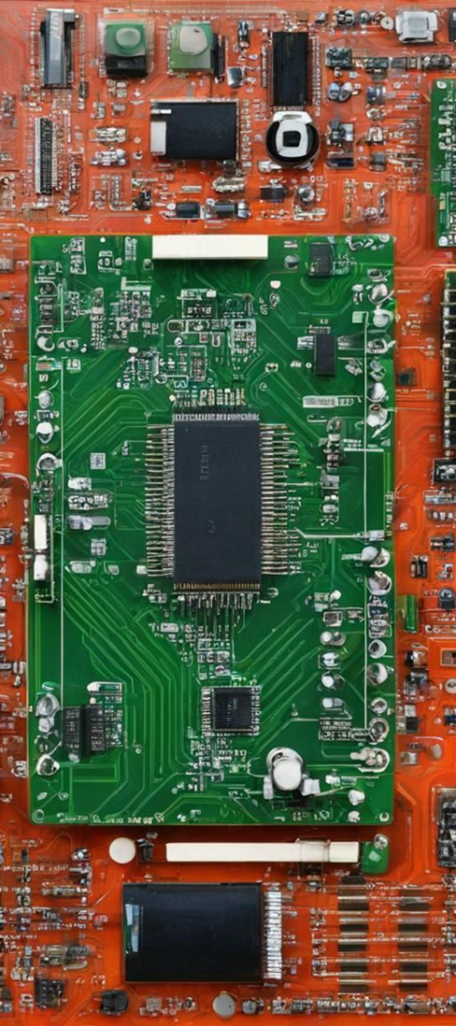
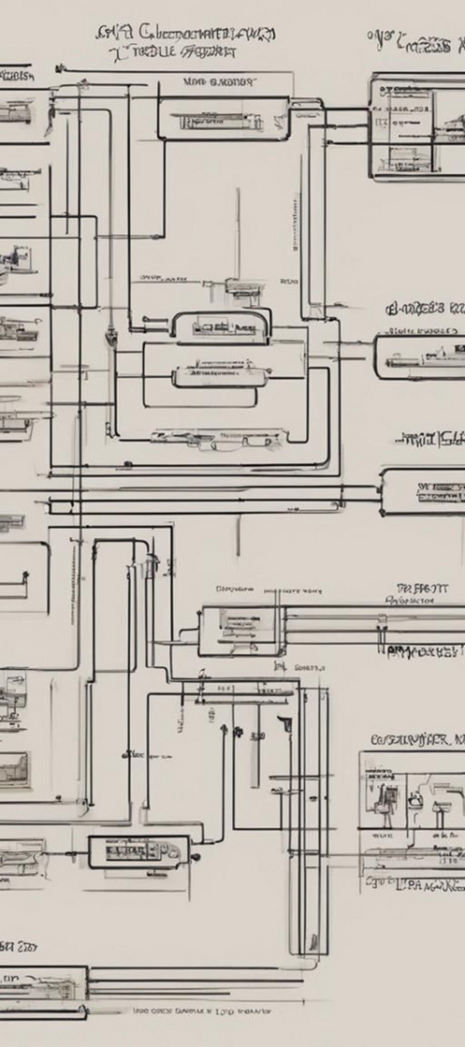



FINAL REPORT
C24
2 HMV
Pay It Forward

Slide 2





Instructor: Dương Ngọc Hoàn

Slide 3

INTRODUCTION
Product name: Solving maze car.
Purpose: The product describes the process of finding the path to the destination in a maze. The product includes 5 basic blocks for finding directions. Besides, the product also has the ability to develop in finding the shortest path

Slide 4
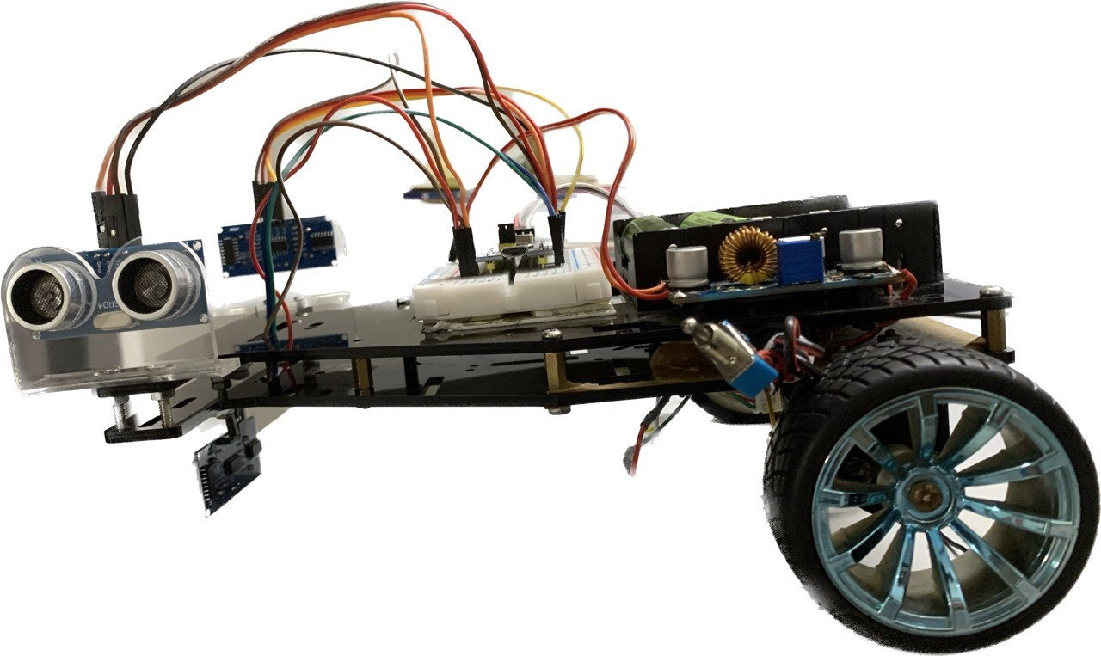

HARDWARE

Slide 5

Our Operating principle:
When the car moves to the cells in the maze, it will retrieve information about the walls by ultrasonic sensors and save it in a pre-allocated memory. After receiving wall information, the vehicle will search for the next direction based on the Flood_flow algorithm, this process continues until the vehicle reaches the destination.

Slide 6
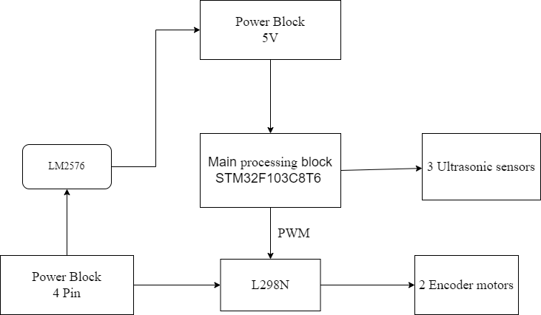
Overall flowchart

Slide 7
Hardware Design
4 main blocks are used in this product
Central processing block:
Power Block
4 pin 3.7/4.2V 6800mAh
use STM32F103C8T6 chip as the central processing block. Receive signals from the sensor and output signals to control the H-bridge circuit for the vehicle to run
Using LM2576 to decrease to 5V for microcontroller

Slide 8
Hardware Design
4 main blocks are used in this product
H-bridge circuit
Ultrasonic Sensor
connected to the microcontroller, the sensor is used to measure distance, determine data as well as send data so the vehicle can navigate.
PWM pulse signal is output from the VCR and signals are input to the pins to control the speed and direction of the vehicle.

Slide 9
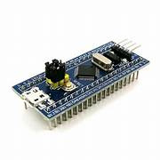
Design of central control block: using STM32F205VCT6
Ultrasonic sensors: communicate with microcontrollers via GPIO.
L298N: communication with control via GPIO with Timer function to pulse PWM output.

Slide 10

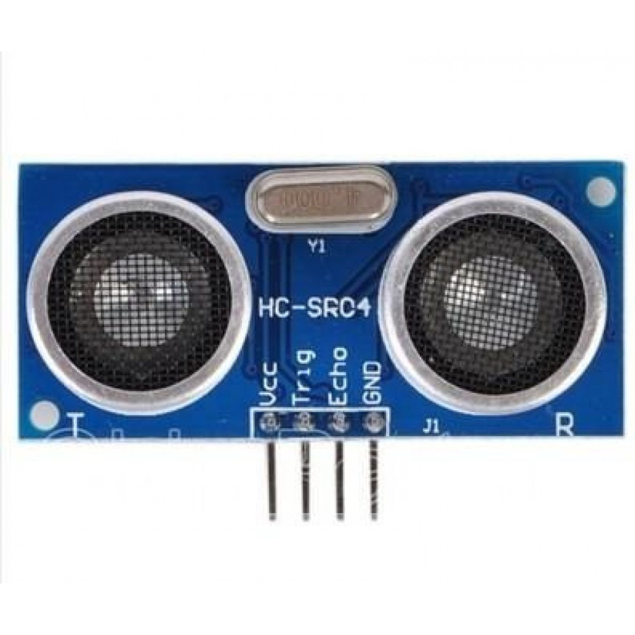
HC-SR04
Working voltage: 5 VDC
Static current: < 2mA.
Output signal: electrical frequency signal, high 5V, low 0V.
Variable angle induction: No more than 15 degrees.
Detection distance: 2cm ~ 450cm.
High precision: Up to 3mm

Slide 11
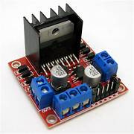
L298N
Main control chip: L298N
Logic voltage: 5 VDC
Power: 5~35 VDC
Logic current: 0~36 mA
Control current: 2A (MAX 1 single H-bridge)
Storage temperature: -20℃ to +135℃
Maximum power: 25W
Dimensions: 43 x 43 x 27mm

Slide 12
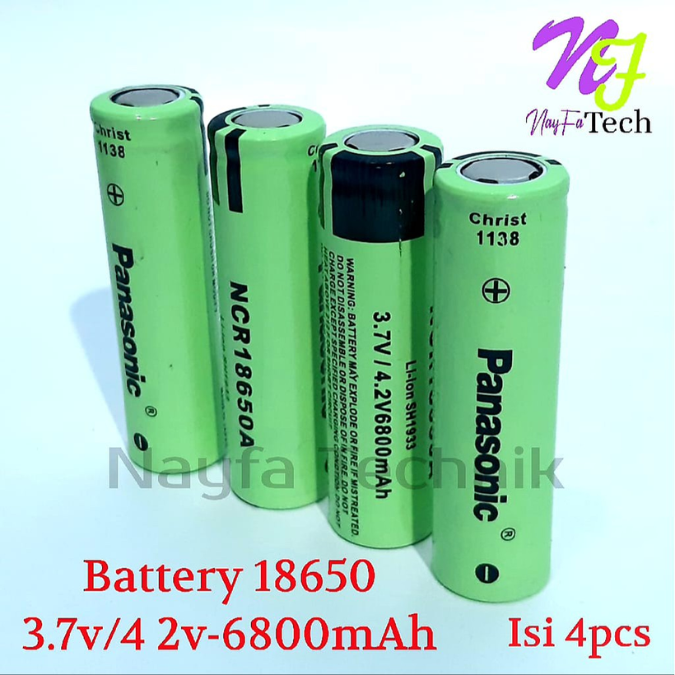
POWER SUPPLY
14-16V power source: 4 batteries.
Rechargeable Battery 3.7/4.2V 6800mAh.
5V voltage regulator circuit uses LM2976.

Slide 13
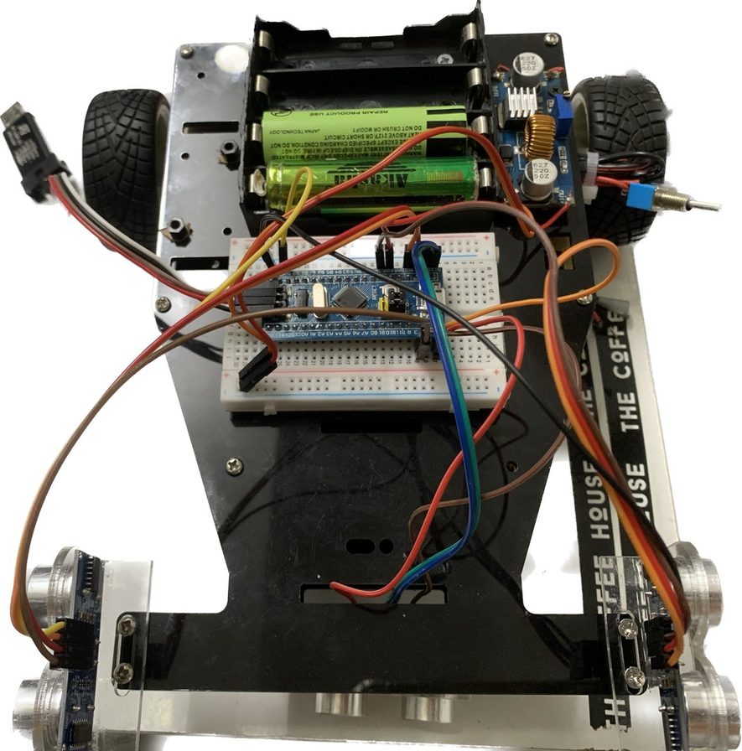
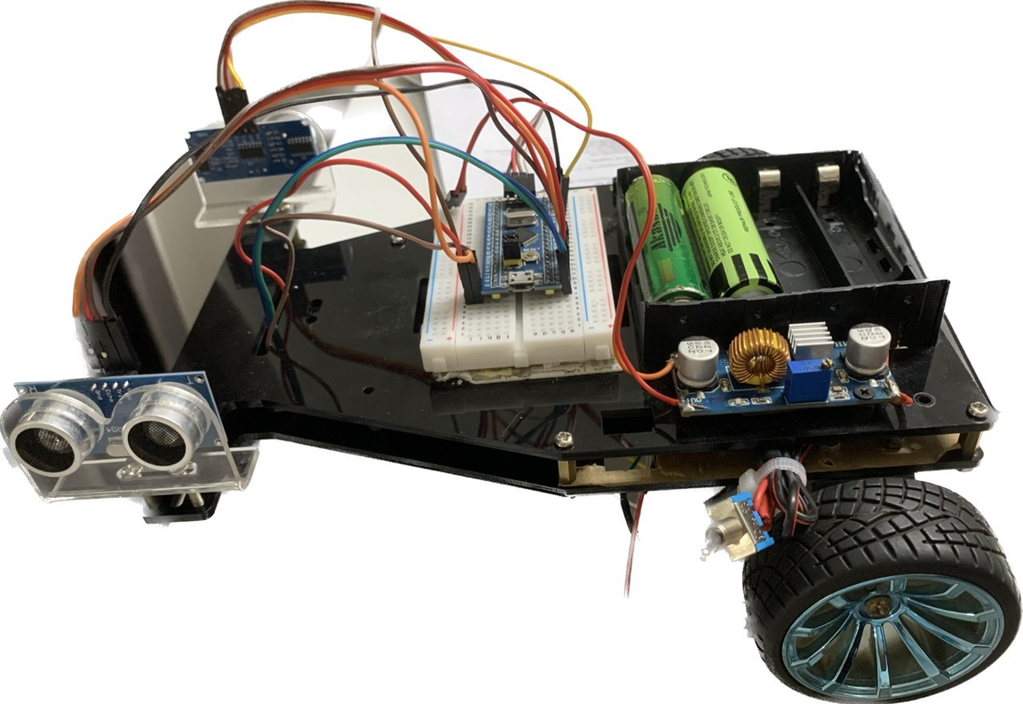
Model car
Front side
Left side

Slide 14
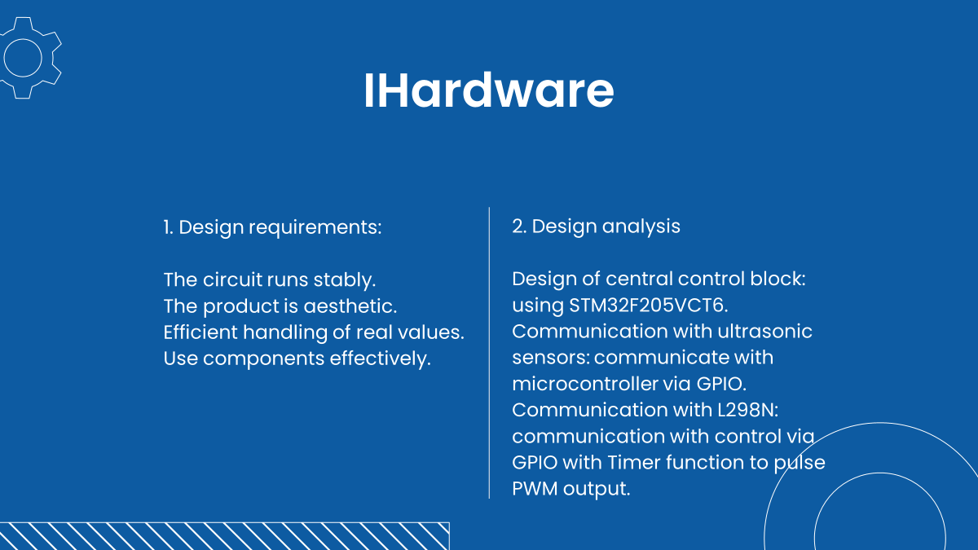

Slide 15
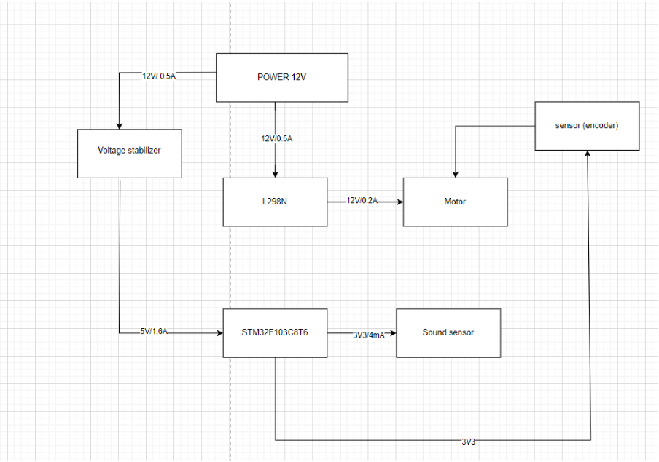
Power block design:
With the 14.8-16.8V source taken from 4 batteries, the voltage is lowered to 5V through STM32 and 3V3 through the ultrasonic sensor.

Slide 16


Slide 17

INTRODUCTION
TO CONTROL PID
SLIDE NOW

Slide 18
Something about PID
In order to achieve a statically stable gait, in spite of external forces and disturbances from the environment.
The basic idea behind a controller is to read a sensor, compare the sensor reading to the desired reading and then compute the actuator input required in order to reach the desired value.

Slide 19
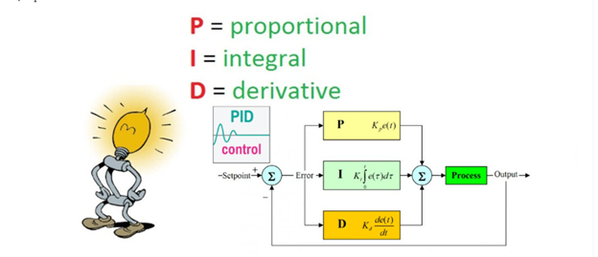
Something about PID
Disadvantage
For the algorithm to work, the beginning and end of the maze must be defined.

Slide 20
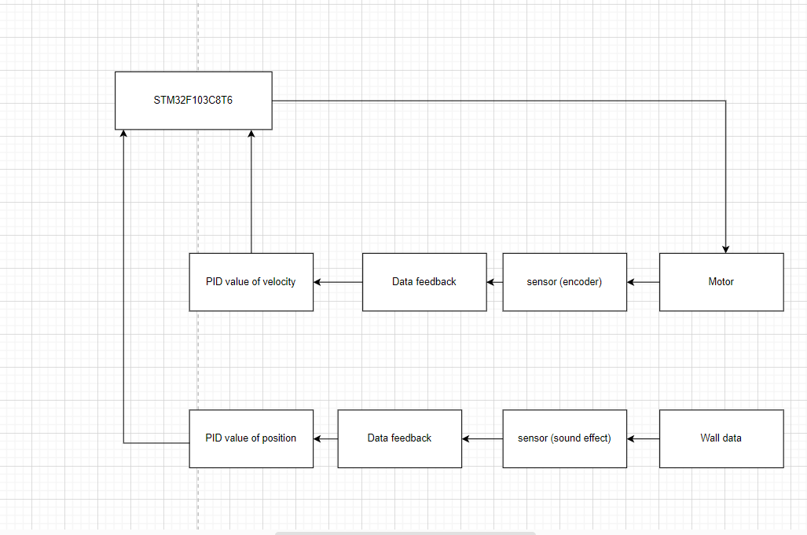
Application PID about the project
Disadvantage

Slide 21
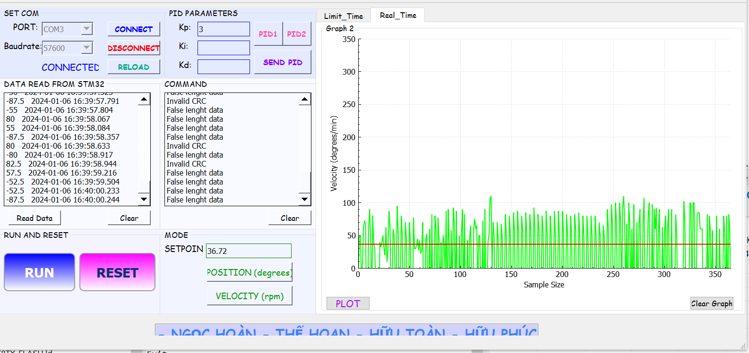
Tuning example PID
Disadvantage
For the algorithm to work, the beginning and end of the maze must be defined.

Slide 22
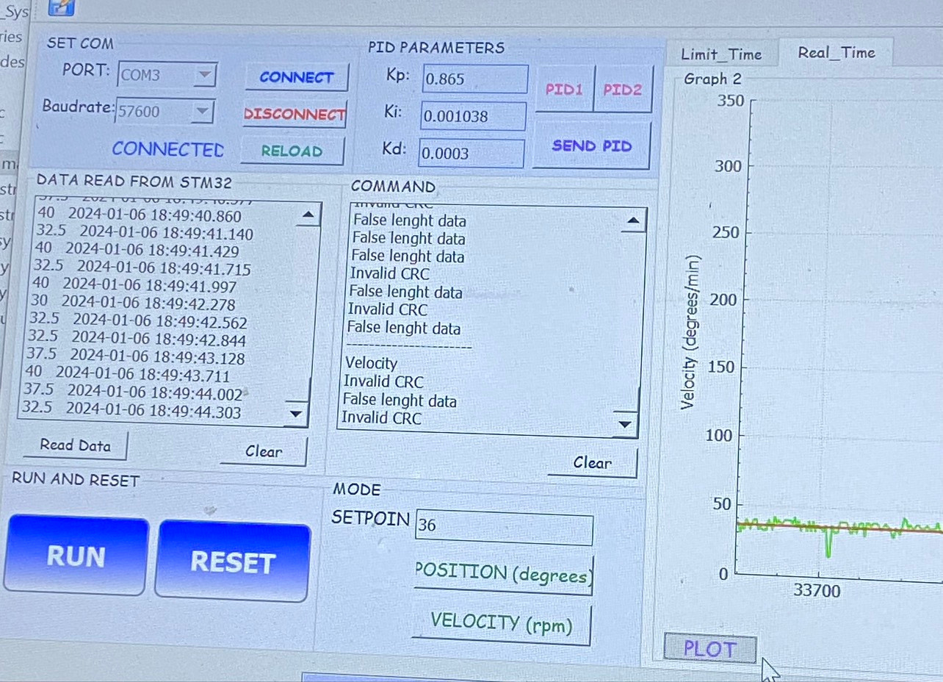
Tuning example PID

Slide 23
Tuning example PID
Tune Kp until there is overshoot and undershoot to provide enough energy for the system.
Tune Kd to reduce the overshoot caused by Kp.
Tune Ki to eliminate remaining setup errors and reduce rise and zero time.
Increase Ki too large to avoid the overshoot from continuing to increase

Slide 24

Flood_Flow Algorithm
Flood fill, also called seed fill, is a flooding algorithm that determines and alters the area connected to a given node in a multidimensional array with some matching attribute.
It is used in the "bucket" fill tool of paint programs to fill connected, similarly-colored areas with a different color, and in games such as Go and Minesweeper for determining which pieces are cleared. A variant called boundary fill uses the same algorithms but is defined as the area connected to a given node that does not have a particular attribute.

Slide 25
Something about Flood_Flow
Advantage
Disadvantage
Help the vehicle find the shortest path to the destination
For the algorithm to work, the beginning and end of the maze must be defined.
Helps the car avoid going around and getting stuck in loops in the maze.

Slide 26
OVERALL EXPLANATION ABOUT FLOOD_FLOW
SLIDE NOW

Slide 27
First
FF operates based on the principle of water movement in an area, it will find the shortest path to the destination through value processing. With assigning values, the principle is to go from high value to low value.

Slide 28
Second
Initially, after determining the size of the maze, the starting and ending positions of the journey. Assume that we don't know the walls in the maze, only the walls outside them. We start assigning initial values to the cells based on the FF value, with the destination point with value 0, and from this point we will fill in the values +1 for the next cell.
There are 4 cells next to the original 1 cell. If it is blocked, there is no need to fill in the value. Continue until all initial values have been filled in.

Slide 29
Third
as the vehicle drives, they will update the walls if encountered. We will use 3 ultrasonic sensors to read whether or not there are walls and save the data. At the same time, the car will check to see whether in the neighboring cells, the cell with the smallest value has a value equal to the value of the current cell -1. If yes, skip the update and move to the smaller cell, otherwise we have to update the current cell value with the smallest neighbor cell value + 1, and also need to update the cells affected by Their value will be different.

Slide 30


Slide 31
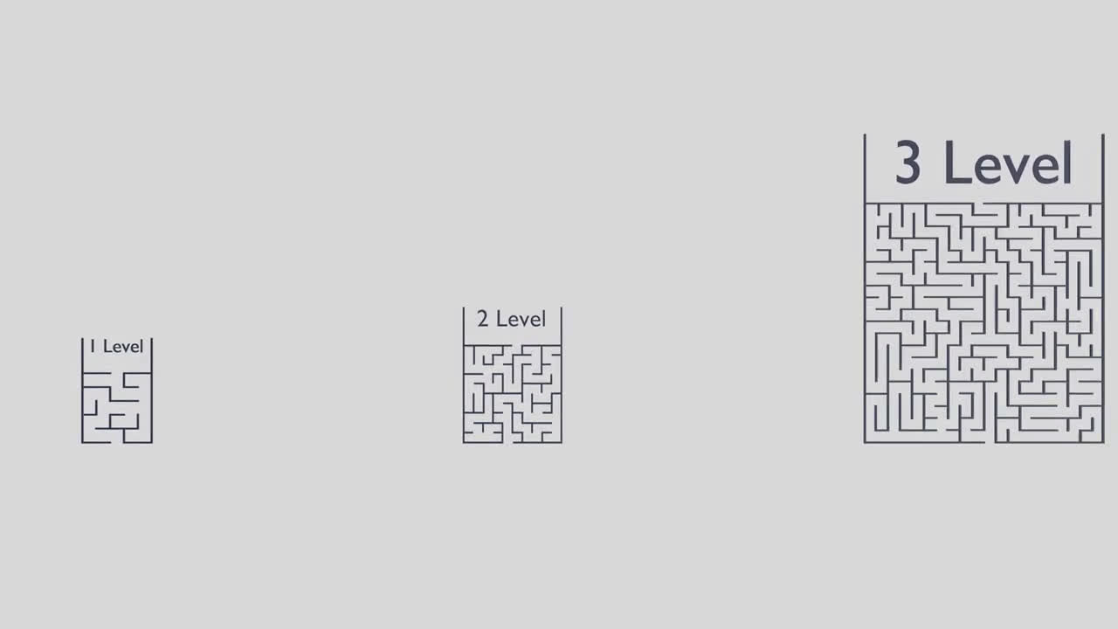

Slide 32
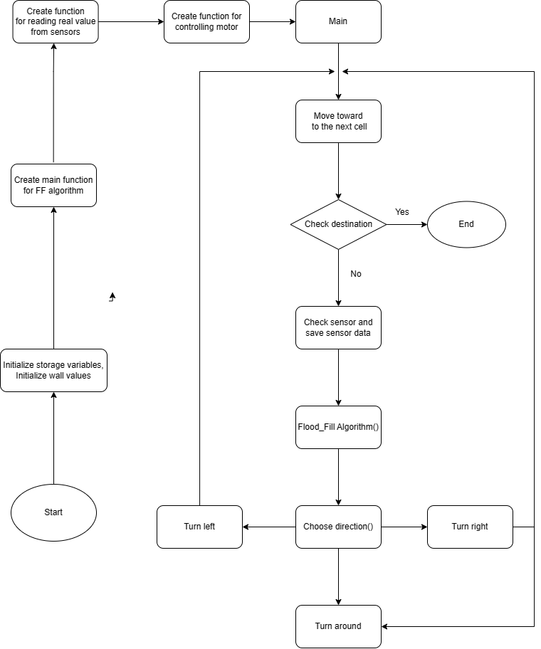
Overall
Algorithm
Flowchart

Slide 33
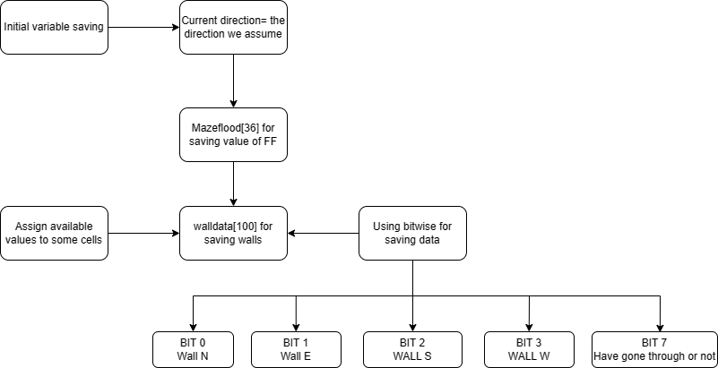
Specific algorithm flowchart
Flowchart of initial variables:

Slide 34
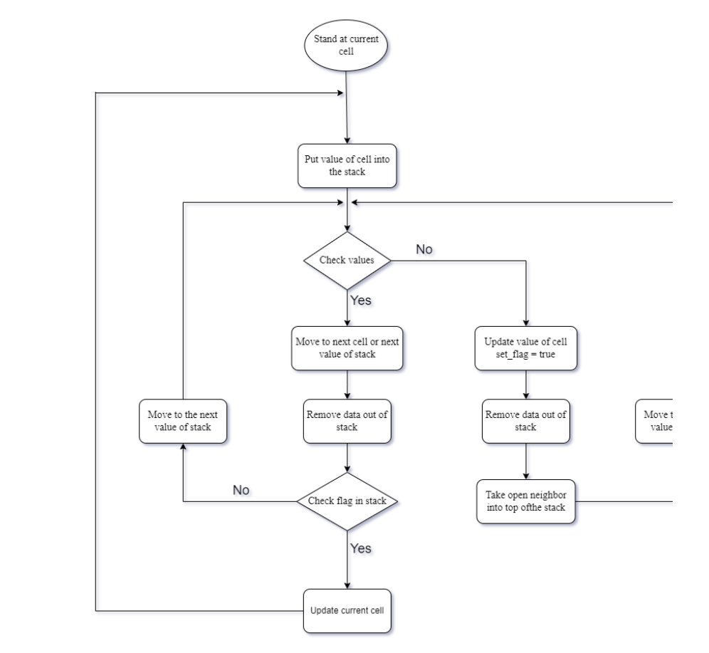
Flowchart of Flood_fill algorithm:

Slide 35
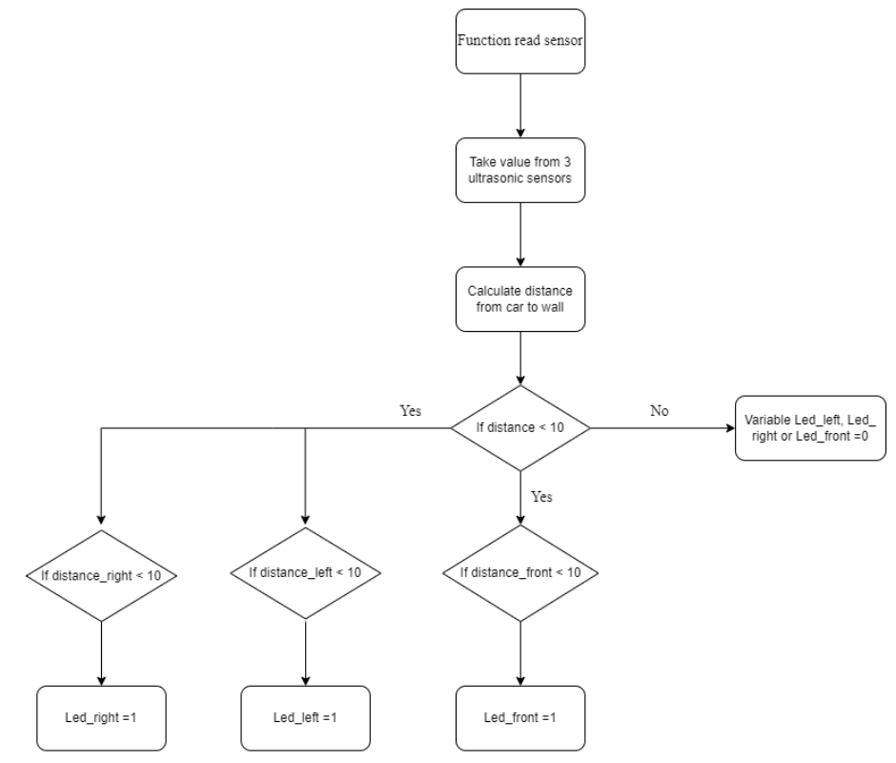
Flowchart of reading ultrasonic sensor:

Slide 36
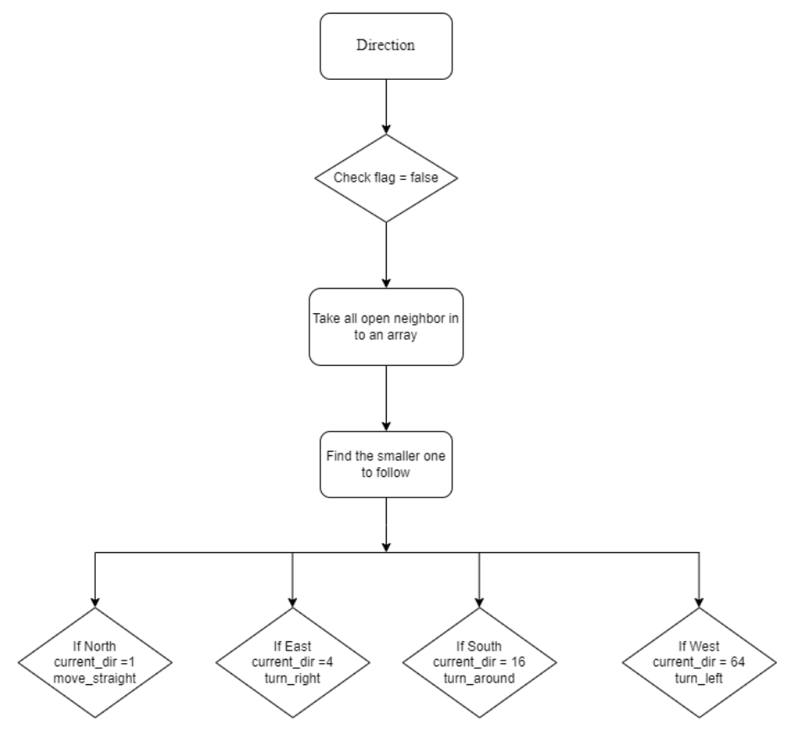
Flowchart of taking direction for car:

Slide 37
RESULT HAS DONE
Advantage: the algorithm has run correctly with the proposed matrix.
Disadvantage: the engine and sensor readings are not optimized, some times the sensor still reads errors, causing line interference.
SLIDE NOW

Slide 38
Development:
Optimize the algorithm, further develop the search for the shortest path after finding the path to the destination.
Optimize the engine to avoid causing unexpected running, misalignment, or incorrect running.
Decreased stopping time in each cell, optimizing route finding time

Slide 39


THANK YOU FOR YOUR ATTENTION

Slide 40


